Slide 1
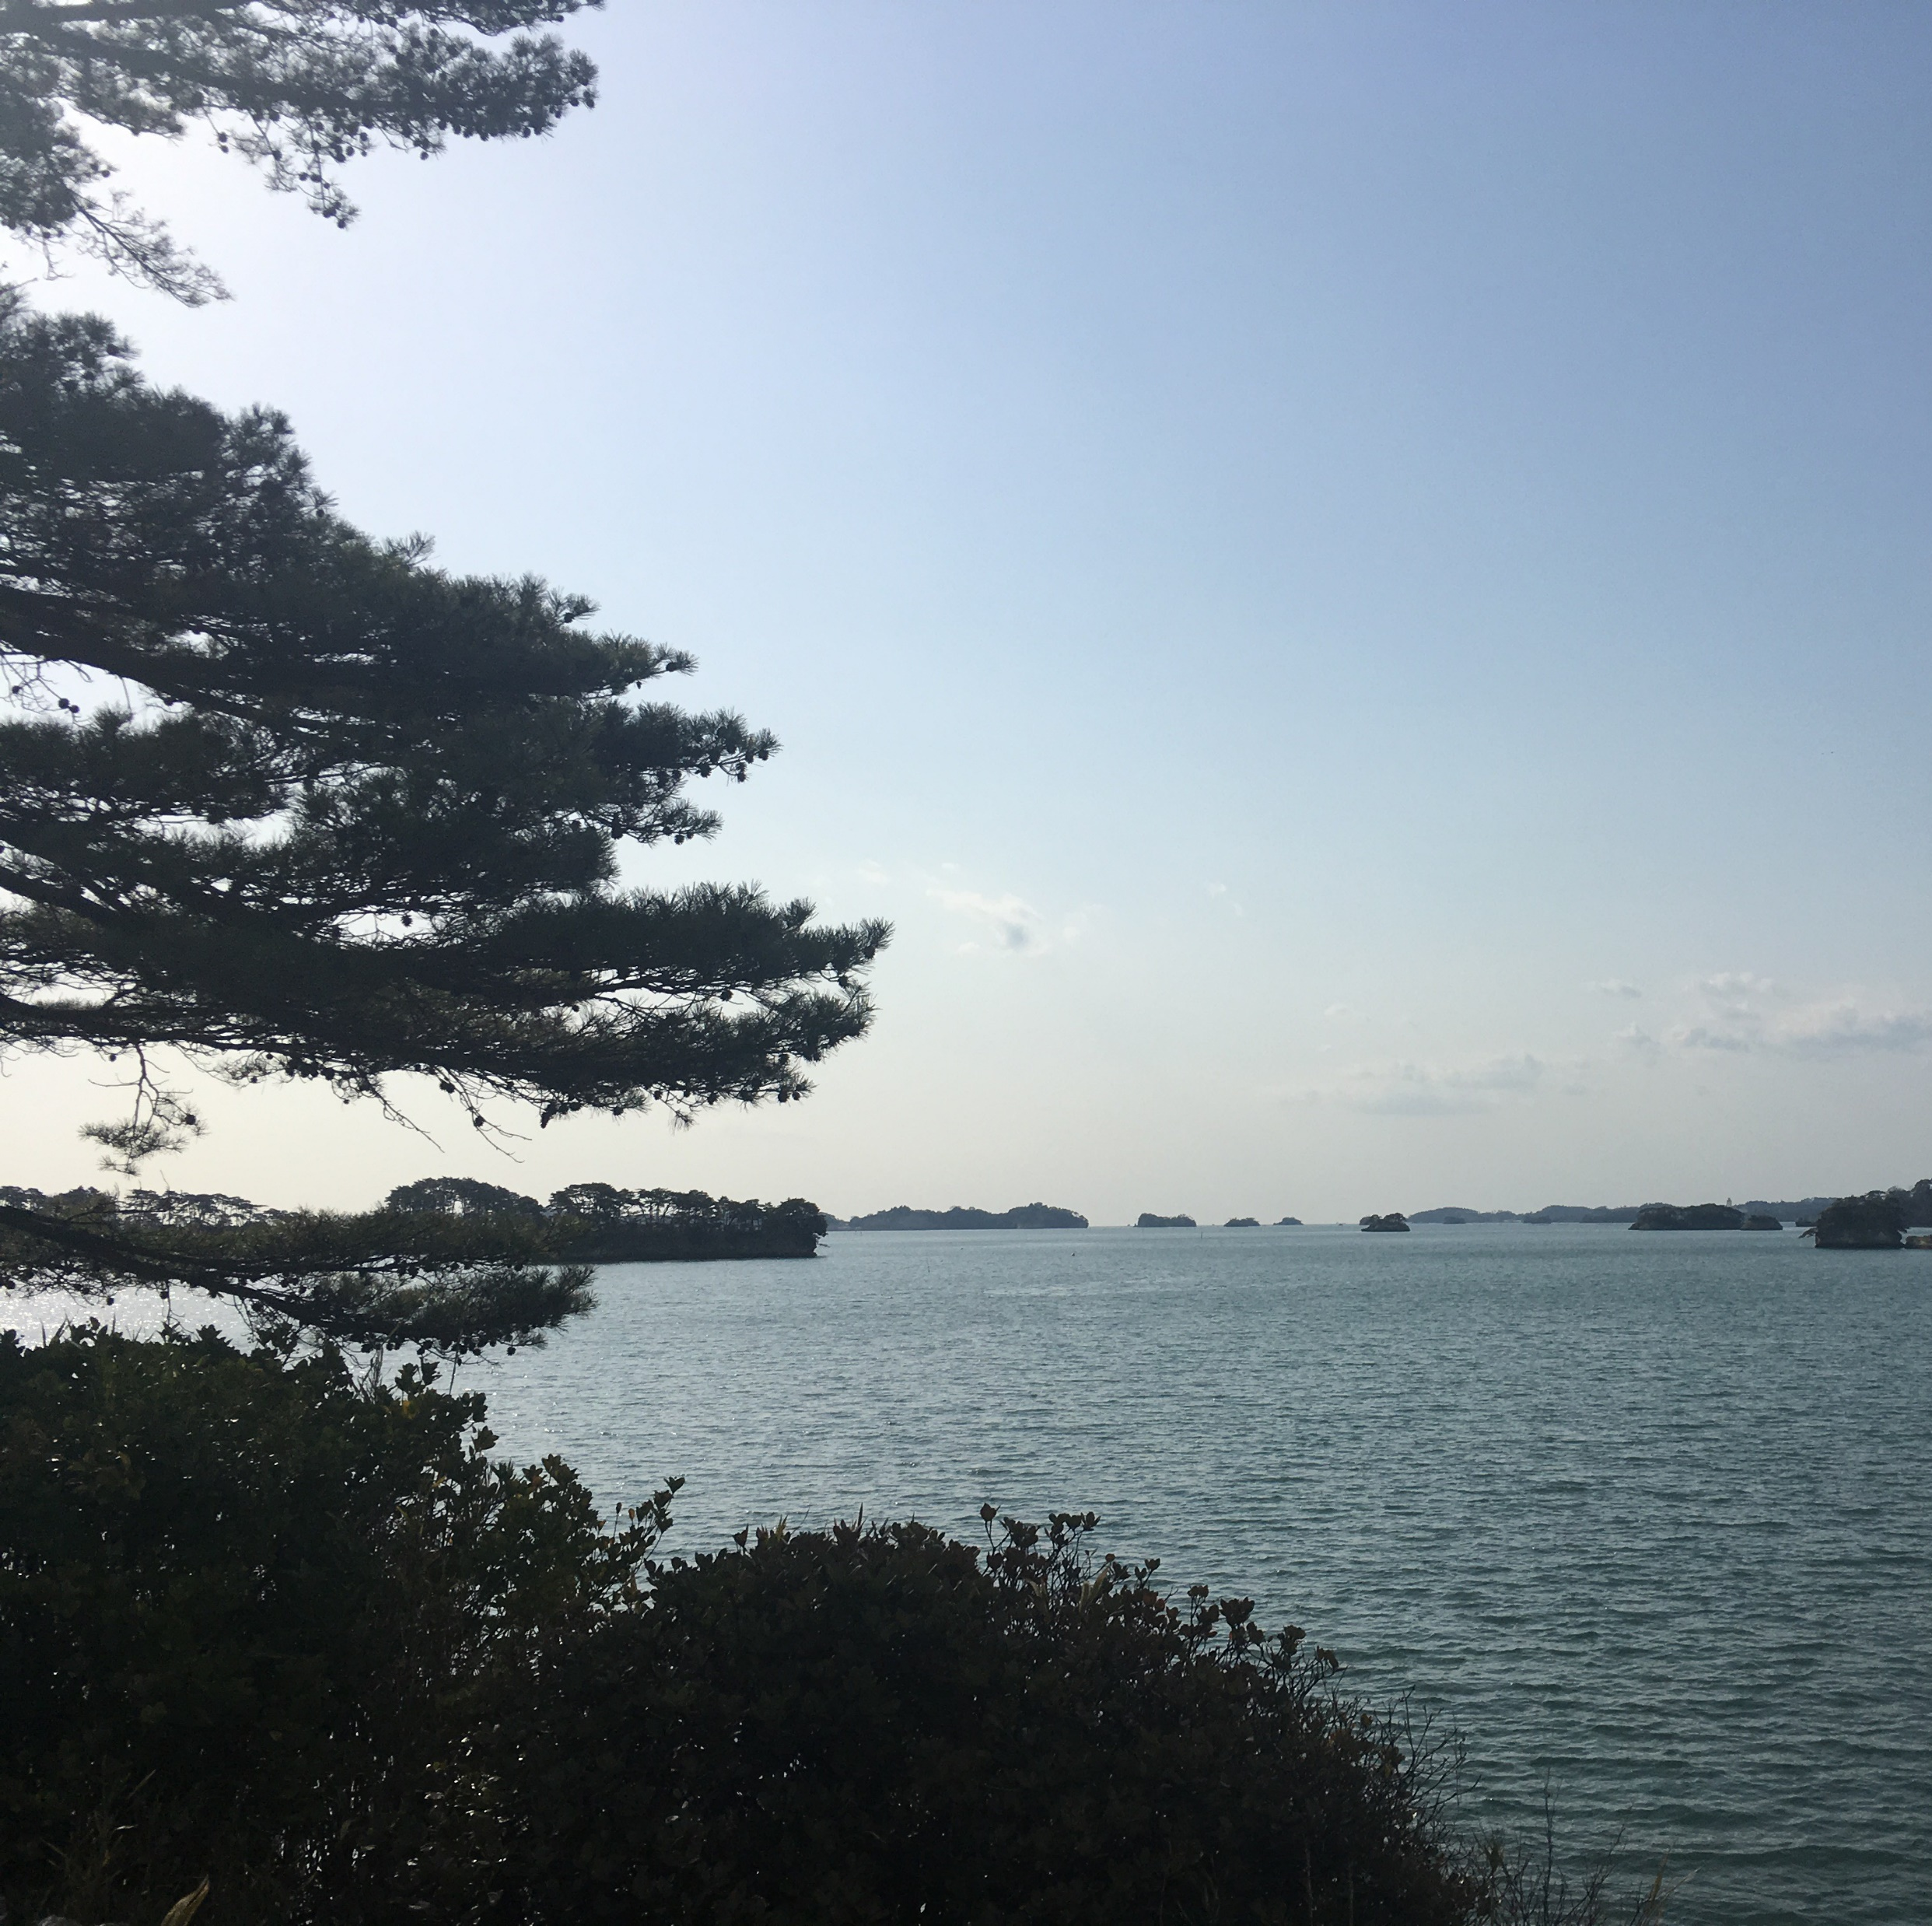
お問い合わせ一覧
アカウント名：Pavlova Stella
出力日：2021/03/29

Slide 2
ケースNo | 件名 | ステータス | 最終更新日 | 作成日
00001002 | Seeking guidance on electrical wiring installation for GC5060 | Closed | 2021/03/29 11:39:54 | 2017/02/07 09:57:38
00001021 | Generator GC3060 platform structure is weakening | Closed | 2017/02/07 09:57:38 | 2017/02/07 09:57:38
00001022 | Signal panel on GC5060 blinks intermittently | Closed | 2017/02/07 09:57:38 | 2017/02/07 09:57:38
00001023 | Electric surge damaging adjacent equipment | Closed | 2019/09/12 15:22:56 | 2017/02/07 09:57:38

